Slide 1


Hashtag Eletro
DASHBOARD
OF SALES
Go to Dashboard

Slide 2









Sales Analysis

Slide 3
Best Product
Best Store

Slide 4




Returns

Slide 5
Sales Analysis

Slide 6


Slide 7
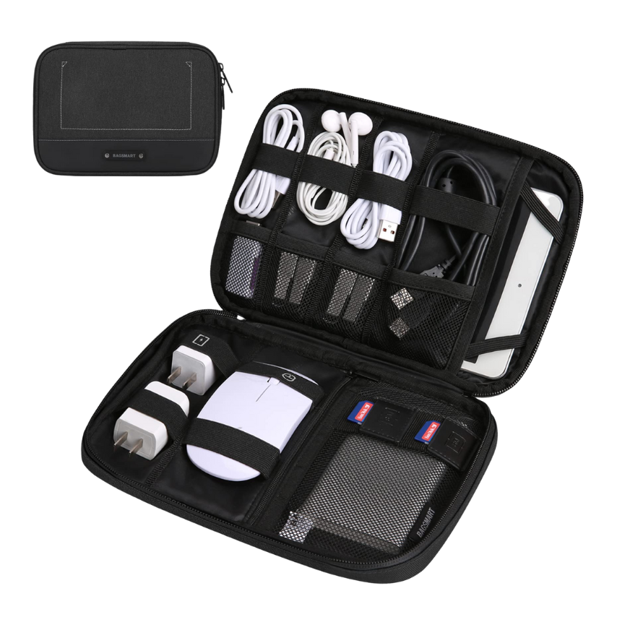
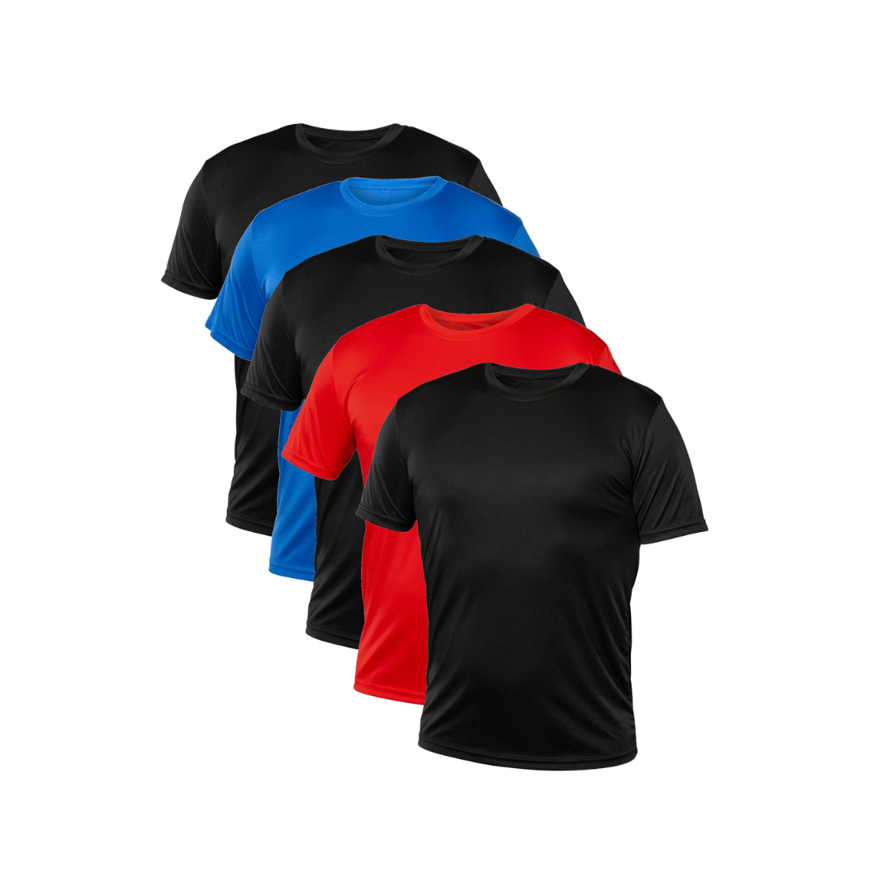
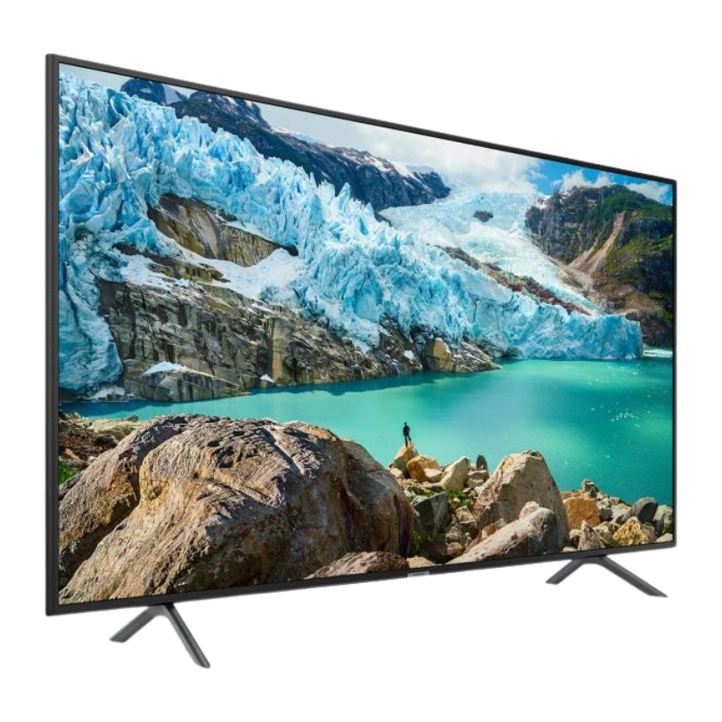


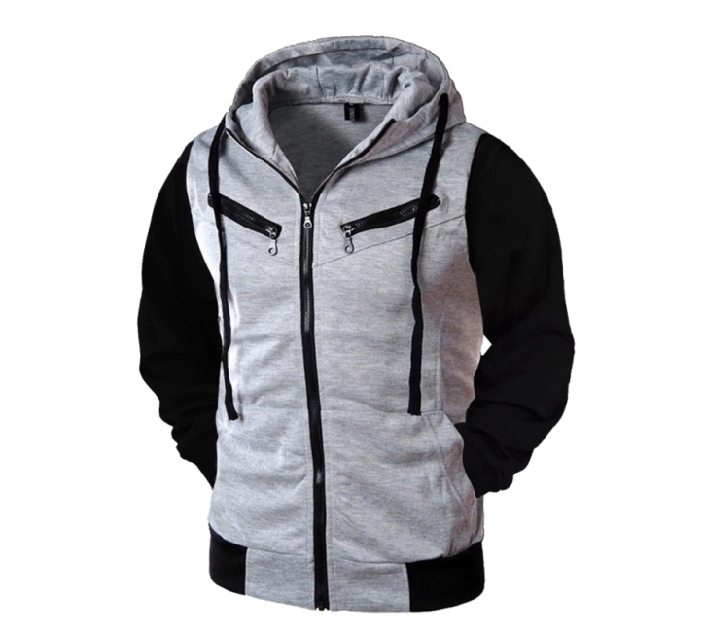
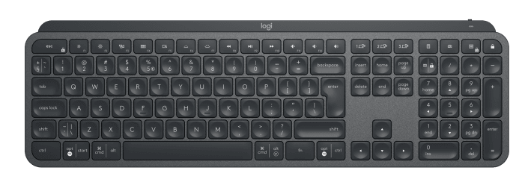

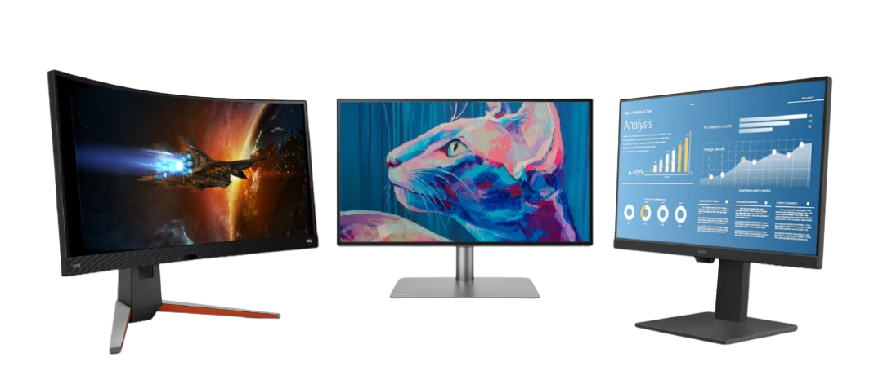
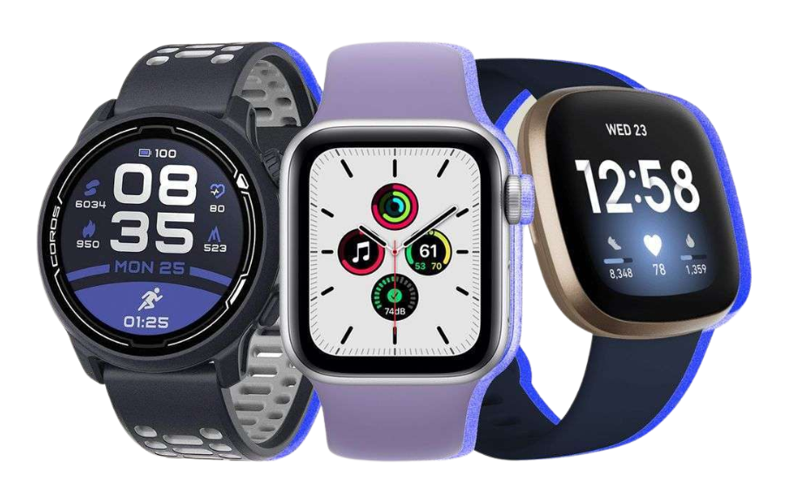


Slide 9
Hover over the graph to see more details

Slide 10
In this graph it is possible to do an analysis by region. By clicking on the ‘+’ button for each continent, you can expand and detail the data for all countries

